Slide 1
Introduction to Computer Science
Data analytics

Slide 2
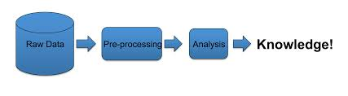
Analytics

Slide 3
Analytics
Different people use the word “analytics” to imply different things.
The different types of analytics. Examples of analytics::
Descriptive
Diagnostic
Prescriptive
Exploratory
Predictive
Mechanistic
Casual
Inferential

Slide 4
Descriptive analytics
The main focus of descriptive analytics is to summarize:
What happened?
What is happening?
Using the raw data or content.

Slide 5
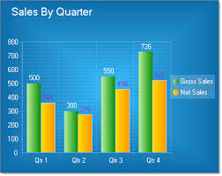
Descriptive analytics
Descriptive analytics is characterized by conventional business intelligence and visualizations such as: bar charts, pie charts, line graphs, or the generated narratives

Slide 6
Diagnostic analytics
Diagnostic analytics is used to unearth or to determine why something happened.
For example, if you’re conducting a social media marketing campaign, you may be interested in assessing the number of likes, reviews, mentions, followers or fans. Diagnostic analytics can help you distill thousands of mentions into a single view so that you can make progress with your campaign.

Slide 7
Prescriptive analytics
While most data analytics provides general insights on the subject, prescriptive analytics gives you with a “laser-like” focus to answer precise questions.
For instance, in the healthcare industry, you can use prescriptive analytics to manage the patient population by measuring the number of patients who are clinically obese.
Prescriptive analytics can allow you to add filters in obesity such as obesity with diabetes and cholesterol levels to find out areas where treatment should be focused.

Slide 8
Exploratory analytics
Exploratory analytics is an analytical approach that primarily focuses on identifying general patterns in the raw data to identify outliers and features that might not have been anticipated using other analytical types.
For you to use this approach, you have to understand where the outliers are occurring and how other environmental variables are related to making informed decisions.

Slide 9
Predictive analytics
Predictive analytics is the use of data, machine learning techniques, and statistical algorithms to determine the likelihood of future results based on historical data.

Slide 10
Mechanistic analytics
Mechanistic analytics allow big data scientists to understand clear alterations in procedures or even variables which can result in changing of variables.
The results of mechanistic analytics are determined by equations in engineering and physical sciences. Also, they allow data scientists to determine the parameters if they know the equation.

Slide 11

Causal analytics
Causal analytics allow big data scientists to figure out what is likely to happen if one component of the variable is changed.

Slide 12
Inferential analytics
This approach to analytics takes different theories on the world into account to determine the certain aspects of the large population.

Slide 13
Data analytics
No
No data analysis
Did you summarize the data?
Yes
Yes
Did you report the summaries without interpretation?
Descriptive
No
Did you quantify whether your sceneries are likely to hold in a new sample?
No
Exploratory
Inferential
Yes
No
Are you trying to predict measurement(s) for individuals
No
Are you trying to figure out how changing the average of one measurement affects another?
Yes
Predictive
Yes
Deterministic
Mechanistic
Is the effect you are looking for an average effect or a deterministic effect?
Average
Causal

Slide 14
Common terminologies used in data analytics
Common terminologies used in data analytics
Business Intelligence (BI)
Automatic identification and capture (AIDC)
Avro
Behavioral analytics.
Data science
Data Scientist
Classification analysis
Machine learning
……..

Slide 15
Business Intelligence (BI)

Slide 16
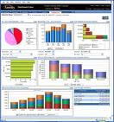


What is Business Intelligence?
Business Intelligence enables the business to make intelligent, fact-based decisions
Aggregate Data
Present
Data
Enrich
Data
Inform a Decision
Database, Data Mart, Data Warehouse, ETL Tools, Integration Tools
Reporting Tools, Dashboards, Static Reports, Mobile Reporting, OLAP Cubes
Add Context to Create Information, Descriptive Statistics, Benchmarks, Variance to Plan or LY
Decisions are Fact-based and Data-driven

Slide 17
Data / information / knowledge
Data – a collection of raw value elements or facts used for calculating, reasoning, or measuring.
Information – the result of collecting and organizing data in a way that establishes relationship between data items, which thereby provides context and meaning
Knowledge – the concept of understanding information based on recognized patterns in a way that provides insight to information.

Slide 18
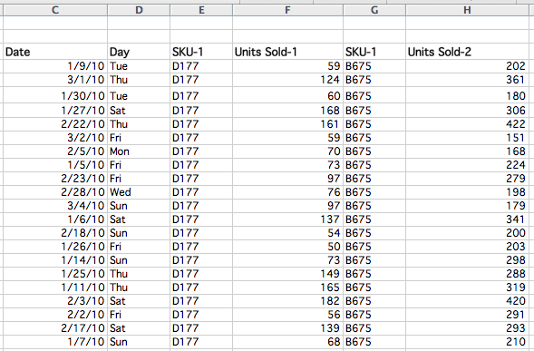
Famous “Beer and Diapers” BI example
Consider the follow convenience-store transactional data (register sales receipts)

Slide 19
Famous “Beer and Diapers” BI example
What did managers learn? That beer & diapers are often bought by men on Thursday and Saturdays. Why?
Data → Information → Knowledge (Insight)

Slide 20
Goal: Convert Data to (Actionable) Knowledge
Knowledge
Info
Increasing
Value
Data
Hard to do in practice – requires commitment/effort.

Slide 21
Database

Slide 22
A Database Schema
Schema Owner
Tables
Indexes
Procedures
Views
Constraints
schema objects
1) Stephens, R.K. and Plew. R.R., 2001. Database Design. SAMS, Indianapolis , IN. (with slight changes by V.G.D.)

Slide 23
Schema objects
Schema objects:
The meaning of “object” here is different than that in UML.

Slide 24
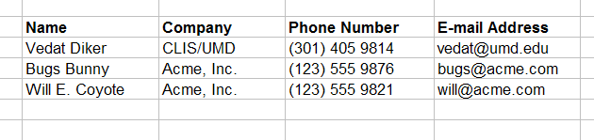
Table
Table:
“A table is the primary unit of physical storage for data in a database.”¹
Usually a database contains more than one table.

Slide 25
A Database with Multiple Tables
Publishers
Books
Customers
Authors
Inventory
Orders

Slide 26
Table (field and row)
Customers
a field
a record(row)

Slide 27
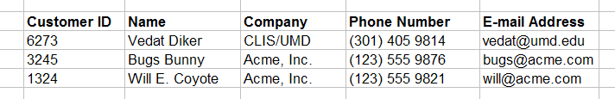
Primary Key
Customers
primary key field
Primary key is a unique identifier of records in a table.
Primary key values may be generated manually or automatically.

Slide 28
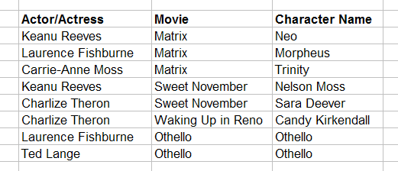
Primary Key
Roles (Performances)
primary key fields
A primary key can consist of more than one field.

Slide 29
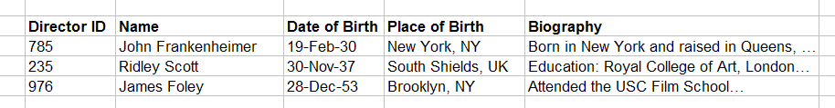
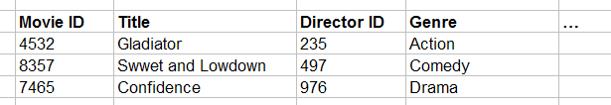
Foreign Key
primary key field
parent table
Directors
relationship
child table
Movies
foreign key field

Slide 30
Relationship Types
One-to-one
One-to-many
Many-to-many

Slide 31
Data Types
Alphanumeric (Text, Memo)
Numeric (Number, Currency, etc.)
Date/Time
Boolean (Yes/No)
….

Slide 32
Entity, instance, relationship
“An entity is a business object that represents a group, or category of data.”¹
“A single, specific occurrence of an entity is an instance. Other terms for an instance are record and tuple.”¹
“An attribute is a sub-group of information within an entity.”¹
A relationship is a link that relates two entities that share one or more attributes.
1) Stephens, R.K. and Plew. R.R., 2001. Database Design, pp. 21. SAMS, Indianapolis , IN.

Slide 33
Database Environments
Mainframe
Client/Server
Internet-based

Slide 34
Database Types
Flat-file
Hierarchical
Network
Relational
Object-oriented
Object-relational

Slide 35
OPERATIONS ON RELATIONS

Slide 36
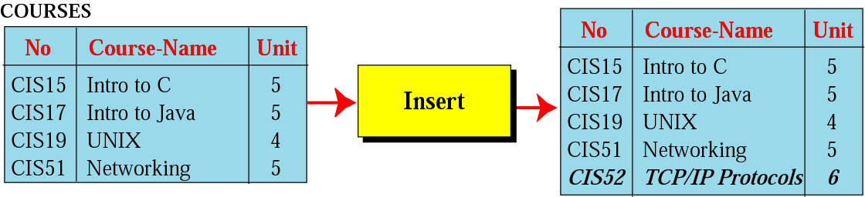
Insert operation
Unary operation
Insert Operation: Inserts new tuple into the relation

Slide 37
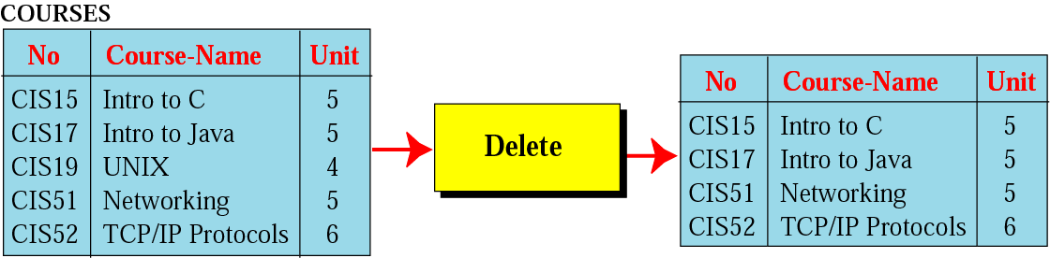
Delete operation
Unary operation
Delete Operation: Deletes tuple from the relation

Slide 38
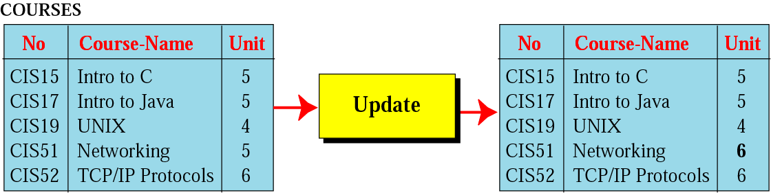
Update operation
Unary operation
Update Operation: Changes the values of some attributes of a tulpe

Slide 39
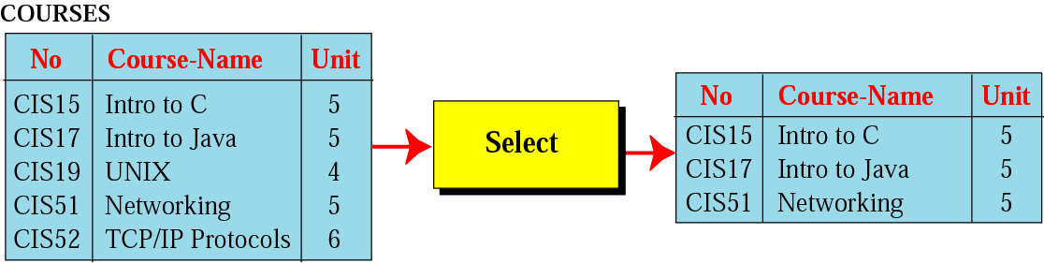
Select operation
Unary operation
Select Operation: Uses some criteria to select some tuples from the original relation

Slide 40
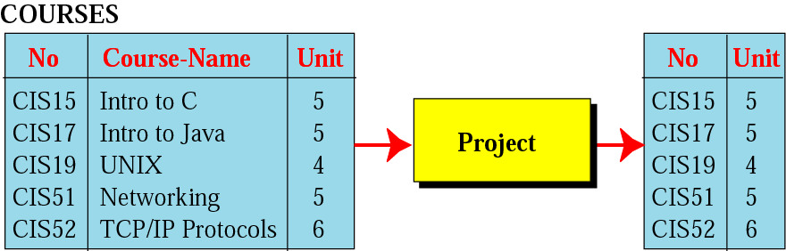
Project operation
Unary operation
Project Operation: Creates relation in which each tulpe has fewer attributes

Slide 41
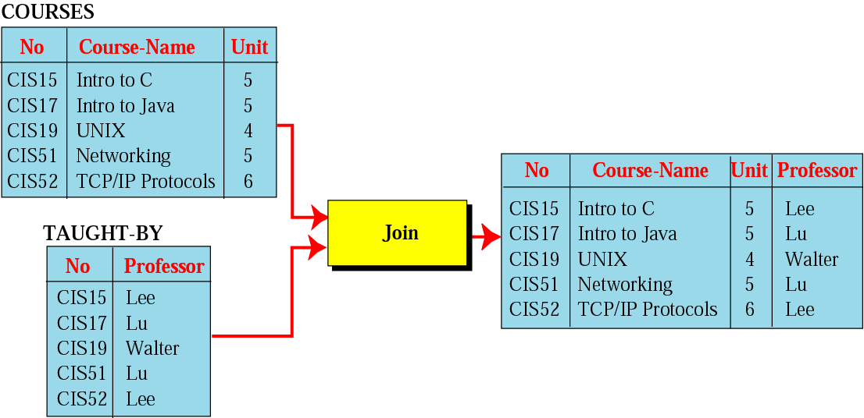
Join operation
Binary operation
Join Operation: Takes two relation and combine them based on common attribute

Slide 42
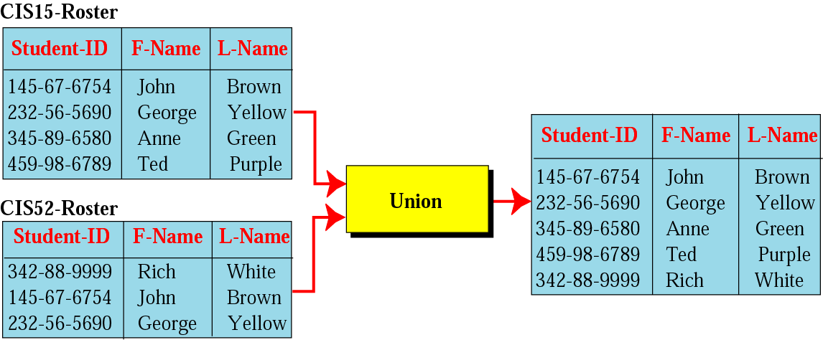
Union operation
Binary operation
Union Operation: Creates new relation in which each tuple is either in the first relation, the second relation or in both

Slide 43
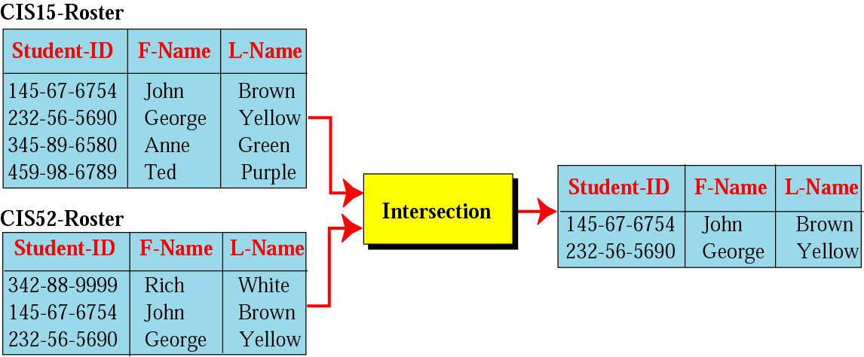
Intersection operation
Binary operation
Intersection Operation: Creates new relation in which each tuple is either in both relations.

Slide 44
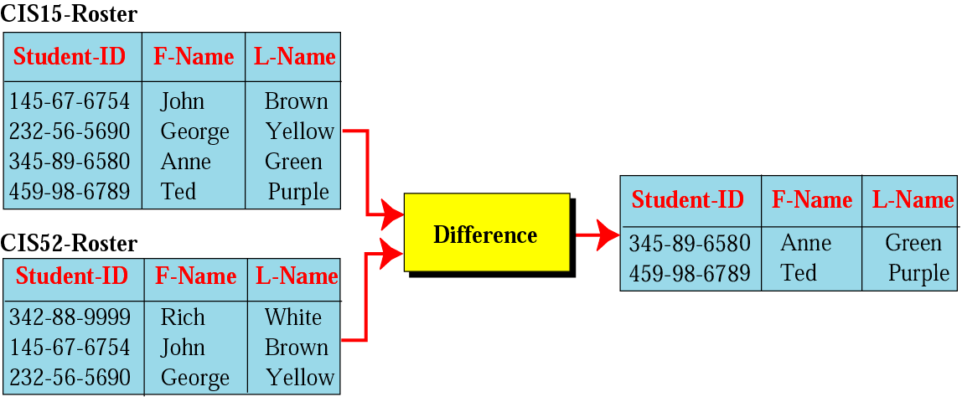
Difference operation
Binary Operation
Difference Operation: Creates new relation where the new tuples are in the first relation but not in the second.

Slide 45
Normalization
A method for organizing data elements into tables.
Done in order to avoid
Duplication of data
Insert anomaly
Delete anomaly
Update anomaly

Slide 46
Normalization
First Normal Form
Second Normal Form
Third Normal Form

Slide 47
Characteristics of Good Database
Ensuring data is valid | Data Integrity
Data is separated from software | Data Independence
Repetition of input data is avoided | Avoiding data Redundancy
Data is not accessible to unauthorized users | Data Security
Set procedures for adding ,deleting … records for the purpose of optimization | Data Maintenance

